Slide 1
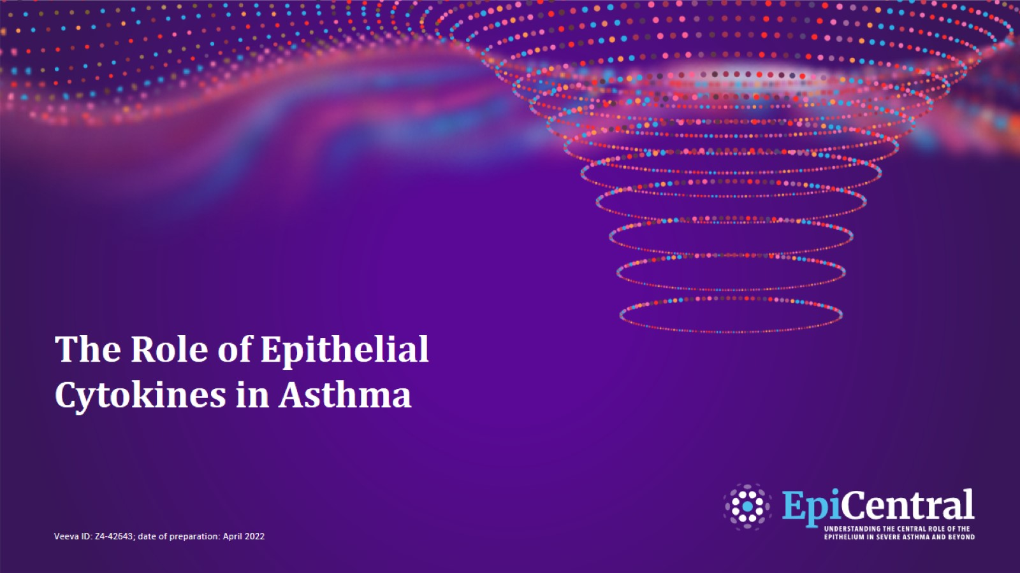
The Role of Epithelial Cytokines in Asthma
CN-142727; date of preparation: Dec 2024. © 2025 AstraZeneca. All Rights Reserved. This information is intended for healthcare professionals only. EpiCentral is sponsored and developed by Amgen and AstraZeneca.

Slide 2
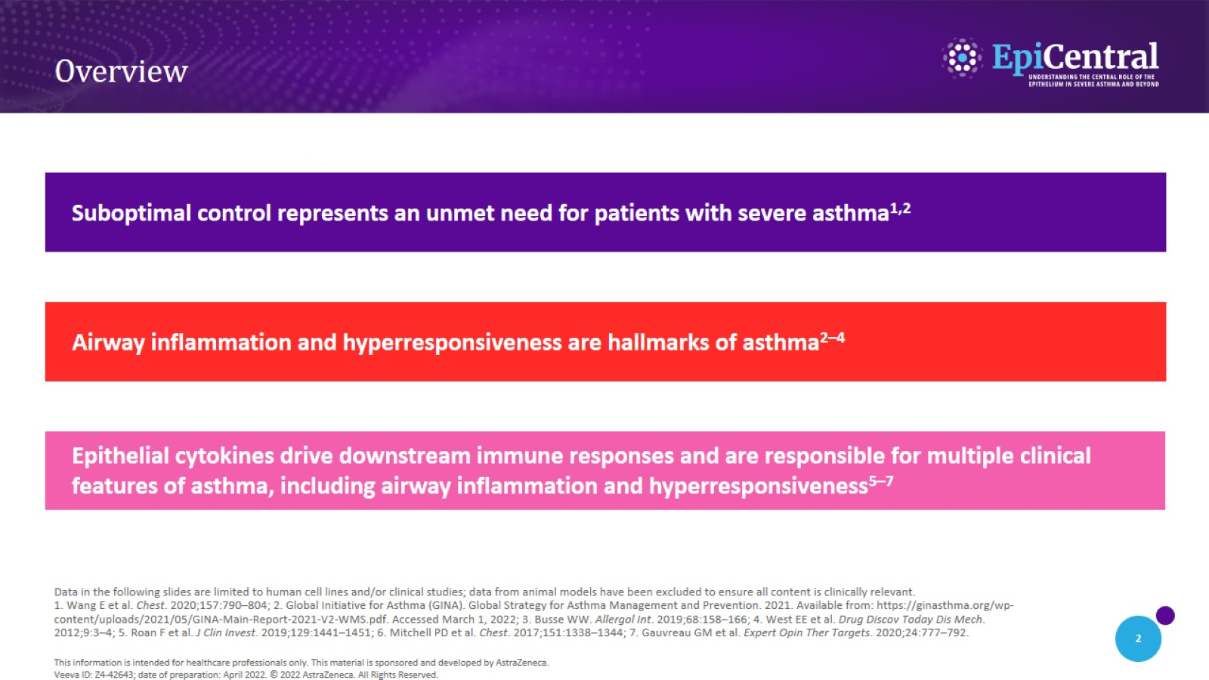
Overview
CN-142727; date of preparation: Dec 2024. © 2025 AstraZeneca. All Rights Reserved. This information is intended for healthcare professionals only. EpiCentral is sponsored and developed by Amgen and AstraZeneca.

Slide 3

The Unmet Needs in
Severe Asthma

Slide 4
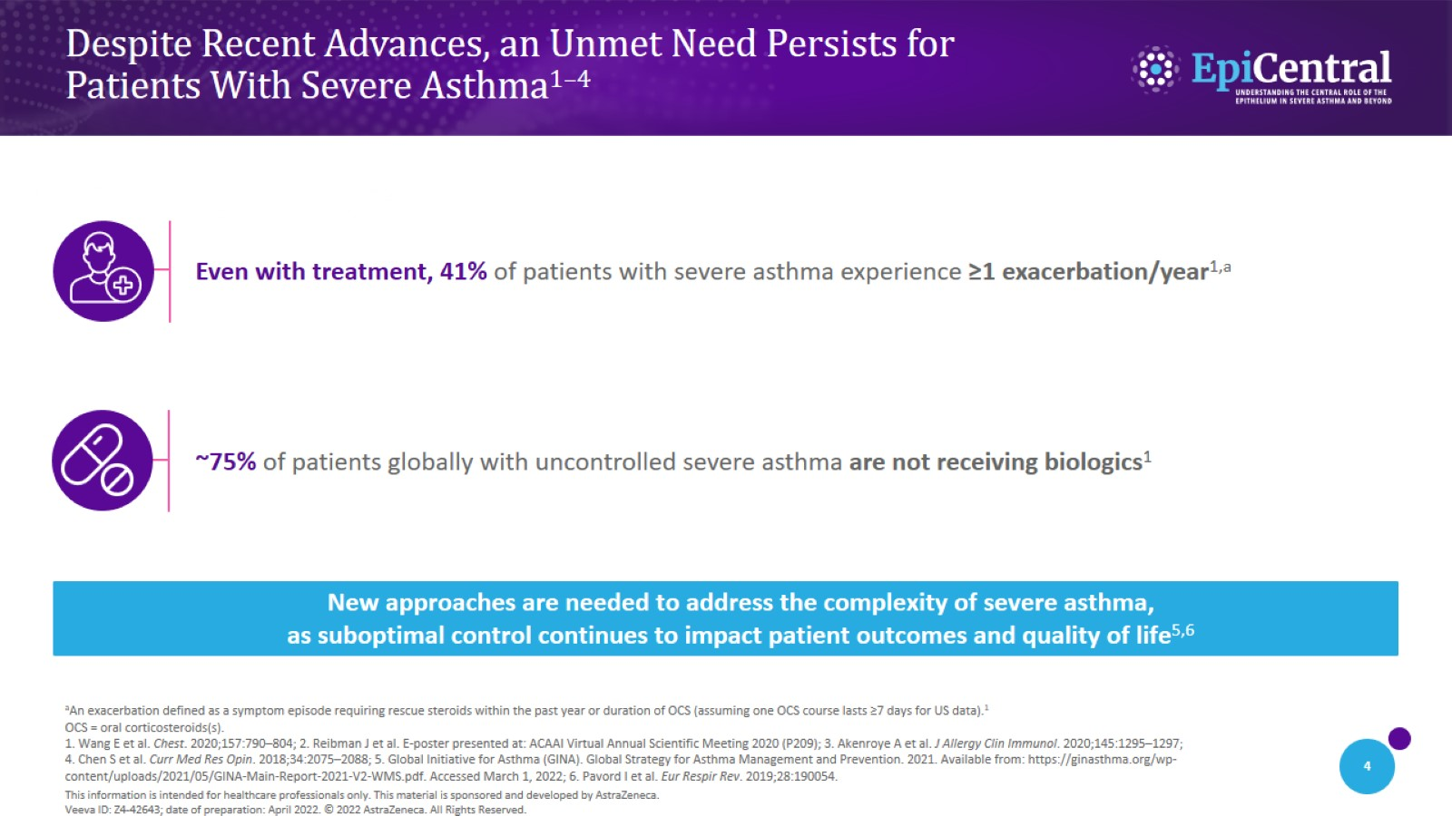
Despite Recent Advances, an Unmet Need Persists for
Patients With Severe Asthma^{1–4}
CN-142727; date of preparation: Dec 2024. © 2025 AstraZeneca. All Rights Reserved. This information is intended for healthcare professionals only. EpiCentral is sponsored and developed by Amgen and AstraZeneca.

Slide 5
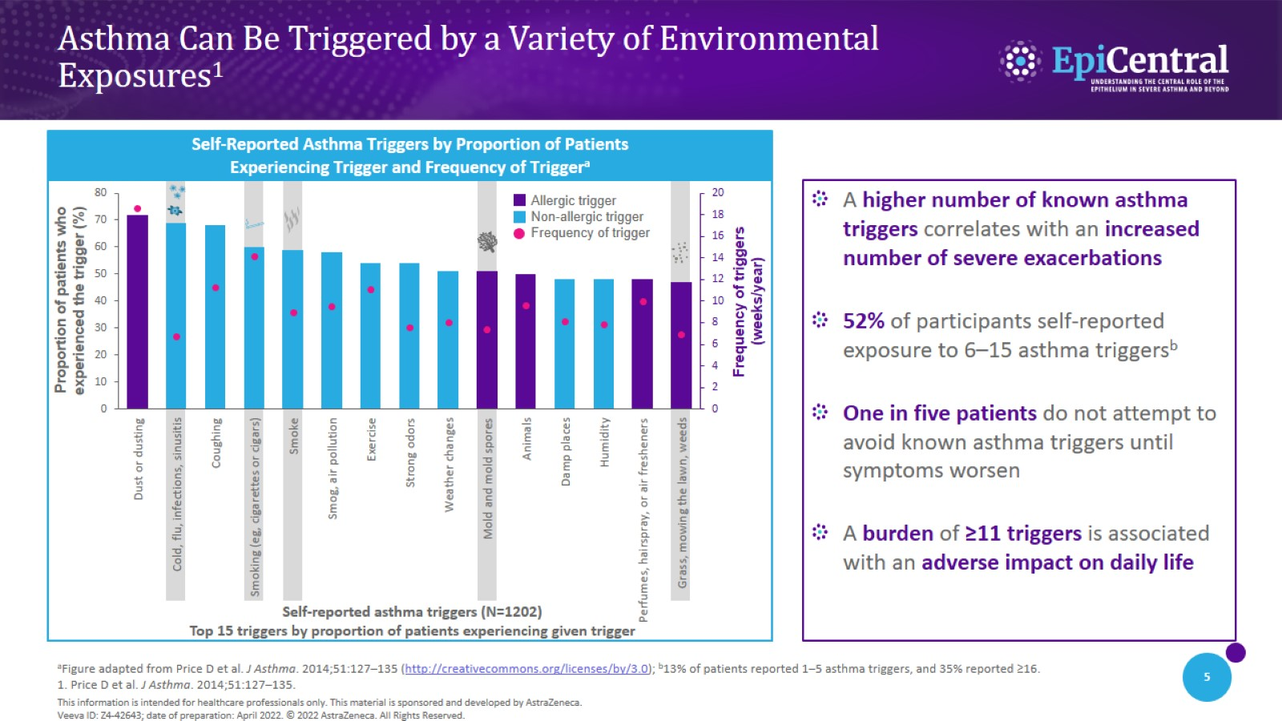
Asthma Can Be Triggered by a Variety of Environmental
Exposures¹
CN-142727; date of preparation: Dec 2024. © 2025 AstraZeneca. All Rights Reserved. This information is intended for healthcare professionals only. EpiCentral is sponsored and developed by Amgen and AstraZeneca.

Slide 6
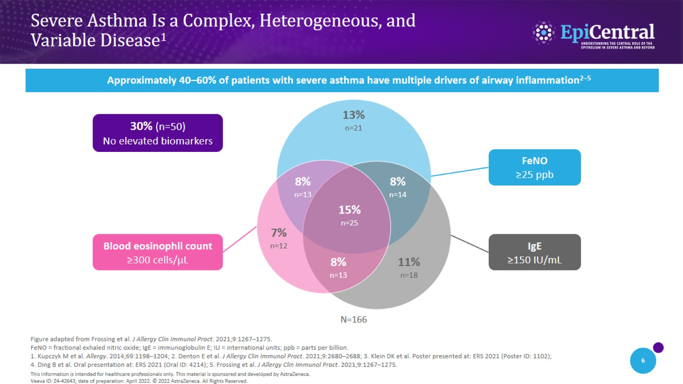
Severe Asthma Is a Complex, Heterogeneous, and
Variable Disease¹
CN-142727; date of preparation: Dec 2024. © 2025 AstraZeneca. All Rights Reserved. This information is intended for healthcare professionals only. EpiCentral is sponsored and developed by Amgen and AstraZeneca.

Slide 7

The Epithelium Drives Hallmarks of Asthma

Slide 8
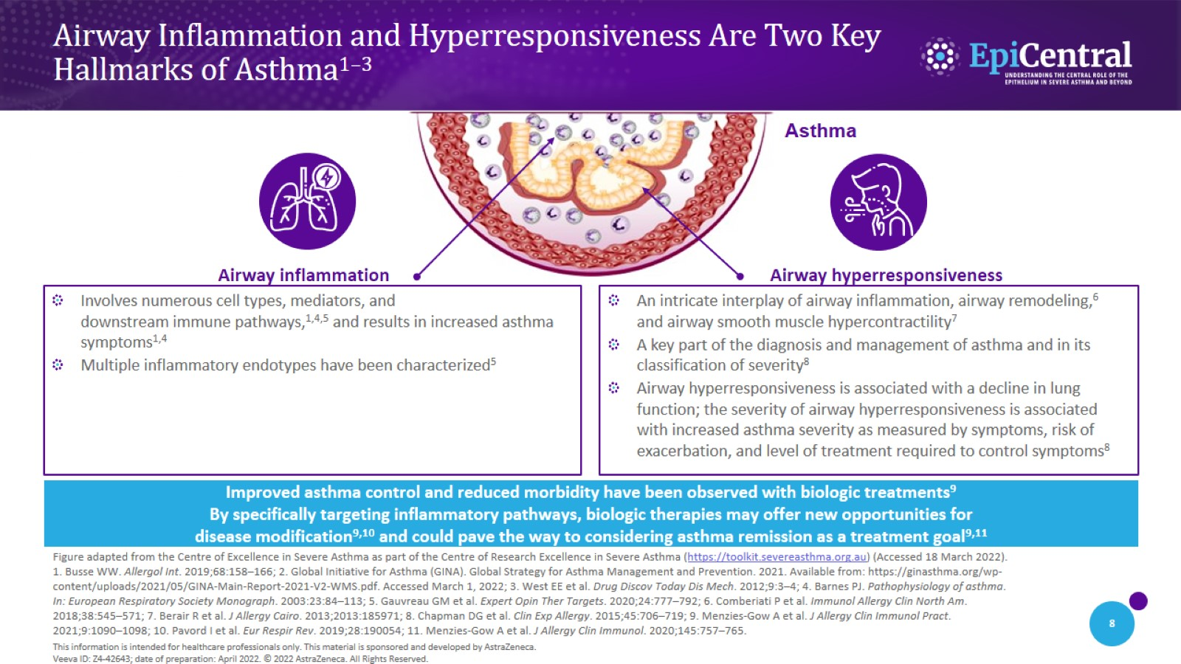
Airway Inflammation and Hyperresponsiveness Are Two Key
Hallmarks of Asthma^{1–3}
CN-142727; date of preparation: Dec 2024. © 2025 AstraZeneca. All Rights Reserved. This information is intended for healthcare professionals only. EpiCentral is sponsored and developed by Amgen and AstraZeneca.

Slide 9
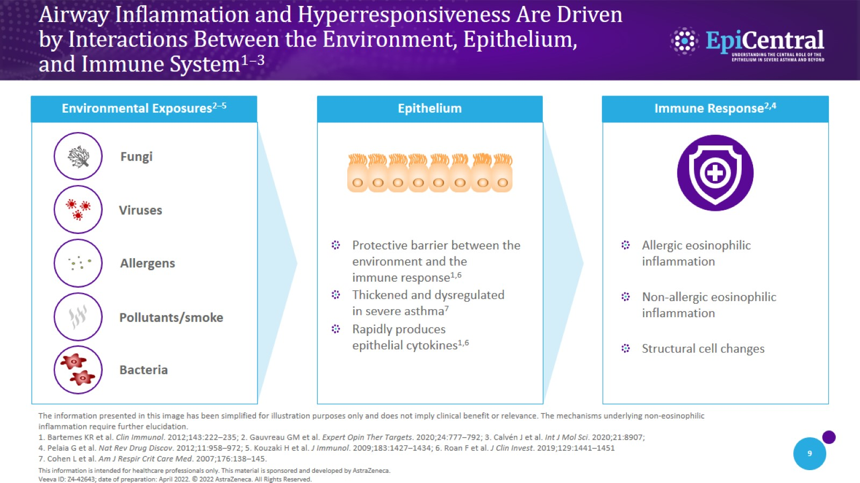
Airway Inflammation and Hyperresponsiveness Are Driven by Interactions Between the Environment, Epithelium, and Immune System^{1–3}
CN-142727; date of preparation: Dec 2024. © 2025 AstraZeneca. All Rights Reserved. This information is intended for healthcare professionals only. EpiCentral is sponsored and developed by Amgen and AstraZeneca.

Slide 10
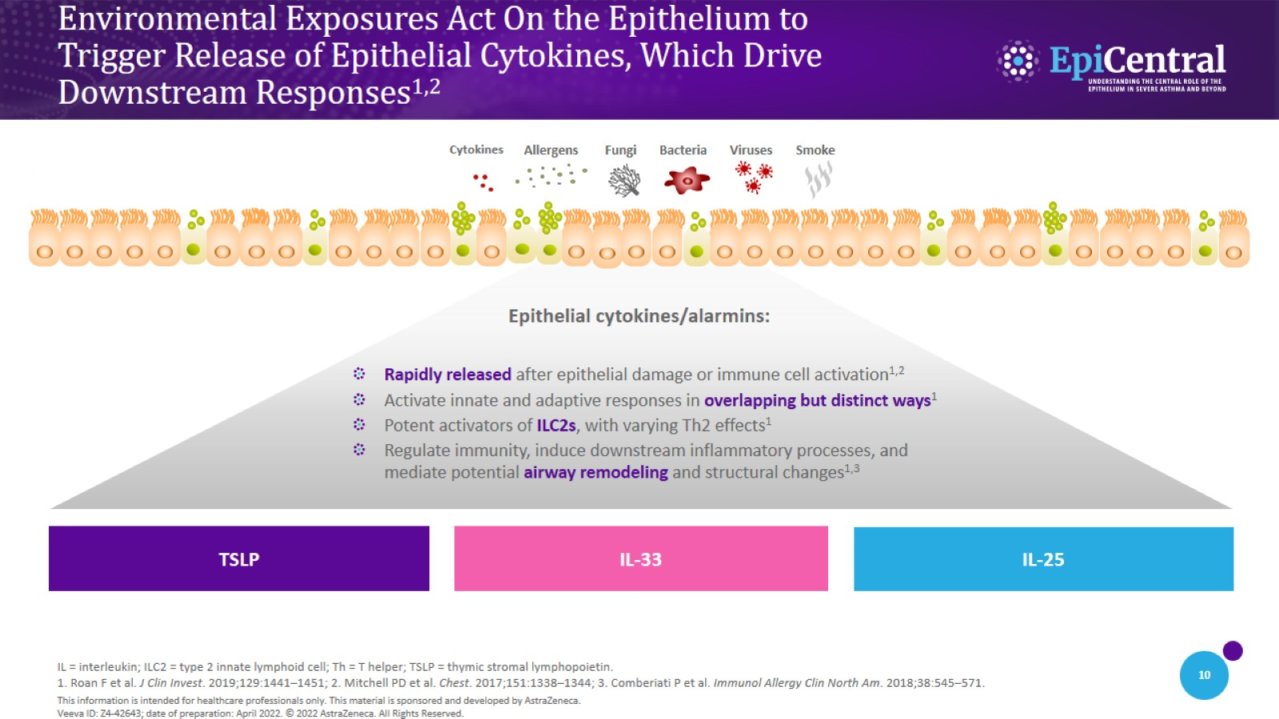
Environmental Exposures Act On the Epithelium to
Trigger Release of Epithelial Cytokines, Which Drive
Downstream Responses^{1,2}
CN-142727; date of preparation: Dec 2024. © 2025 AstraZeneca. All Rights Reserved. This information is intended for healthcare professionals only. EpiCentral is sponsored and developed by Amgen and AstraZeneca.

Slide 11
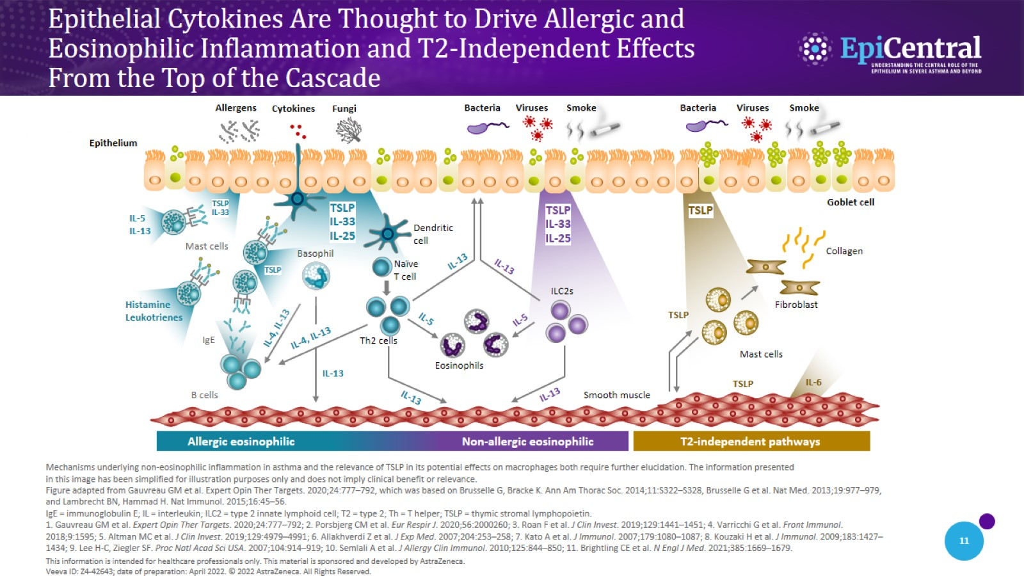
Epithelial Cytokines Are Thought to Drive Allergic and
Eosinophilic Inflammation and T2-Independent Effects
From the Top of the Cascade
CN-142727; date of preparation: Dec 2024. © 2025 AstraZeneca. All Rights Reserved. This information is intended for healthcare professionals only. EpiCentral is sponsored and developed by Amgen and AstraZeneca.

Slide 12
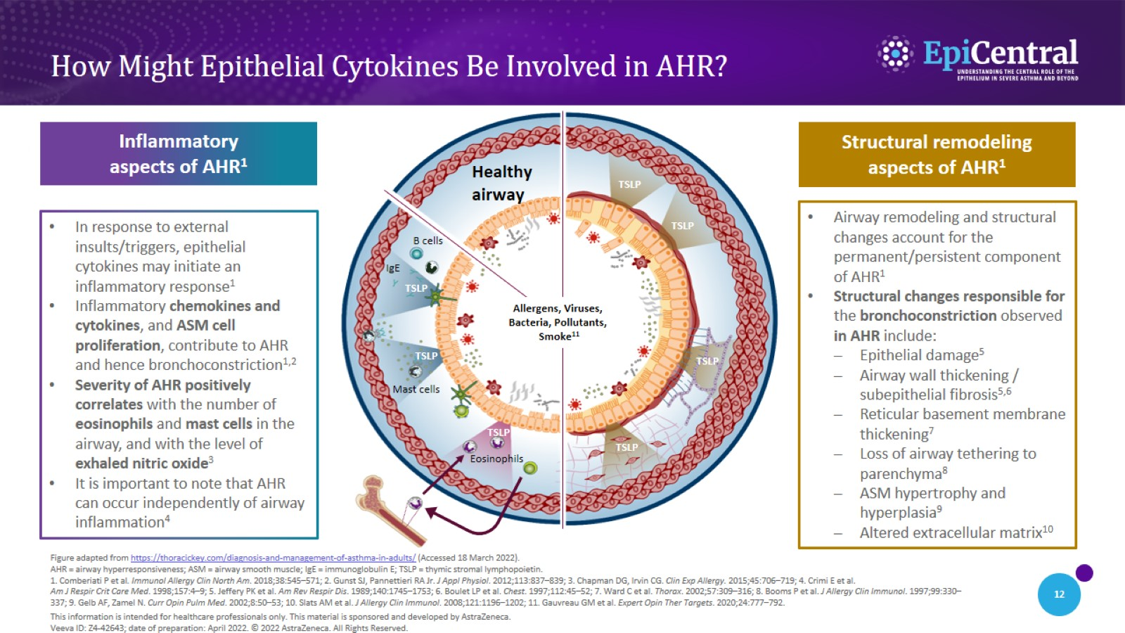
How Might Epithelial Cytokines Be Involved in AHR?
CN-142727; date of preparation: Dec 2024. © 2025 AstraZeneca. All Rights Reserved. This information is intended for healthcare professionals only. EpiCentral is sponsored and developed by Amgen and AstraZeneca.

Slide 13

Epithelial Cytokines in
Severe Asthma

Slide 14
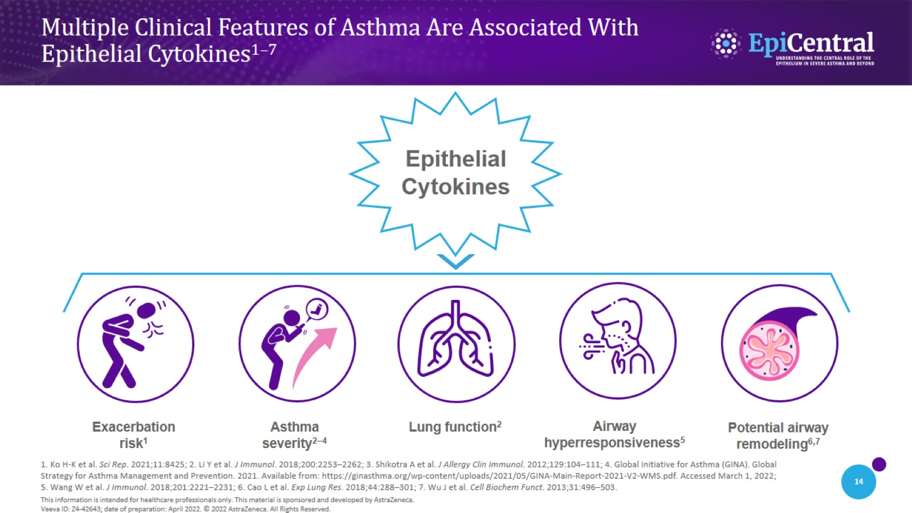
Multiple Clinical Features of Asthma Are Associated With
Epithelial Cytokines^{1–7}
CN-142727; date of preparation: Dec 2024. © 2025 AstraZeneca. All Rights Reserved. This information is intended for healthcare professionals only. EpiCentral is sponsored and developed by Amgen and AstraZeneca.

Slide 15
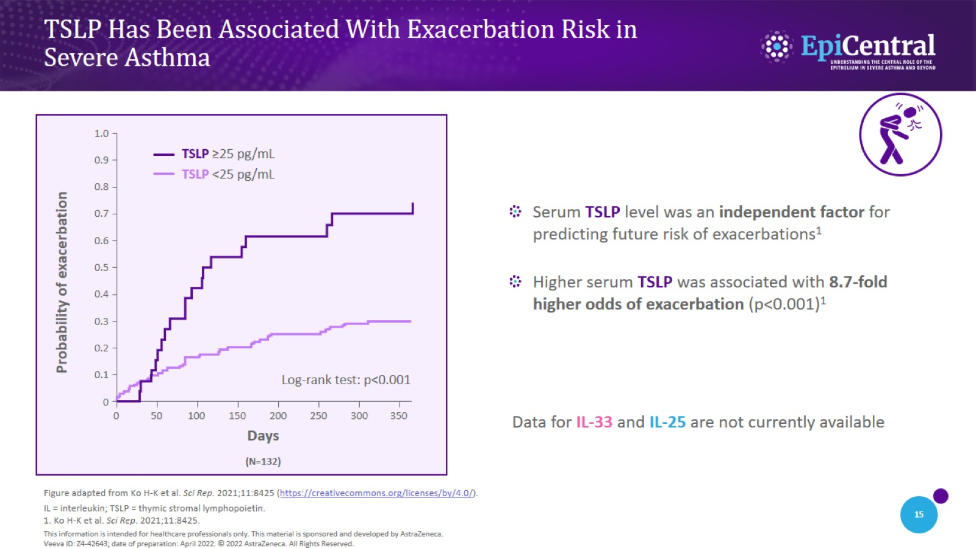
TSLP Has Been Associated With Exacerbation Risk in
Severe Asthma
CN-142727; date of preparation: Dec 2024. © 2025 AstraZeneca. All Rights Reserved. This information is intended for healthcare professionals only. EpiCentral is sponsored and developed by Amgen and AstraZeneca.

Slide 16
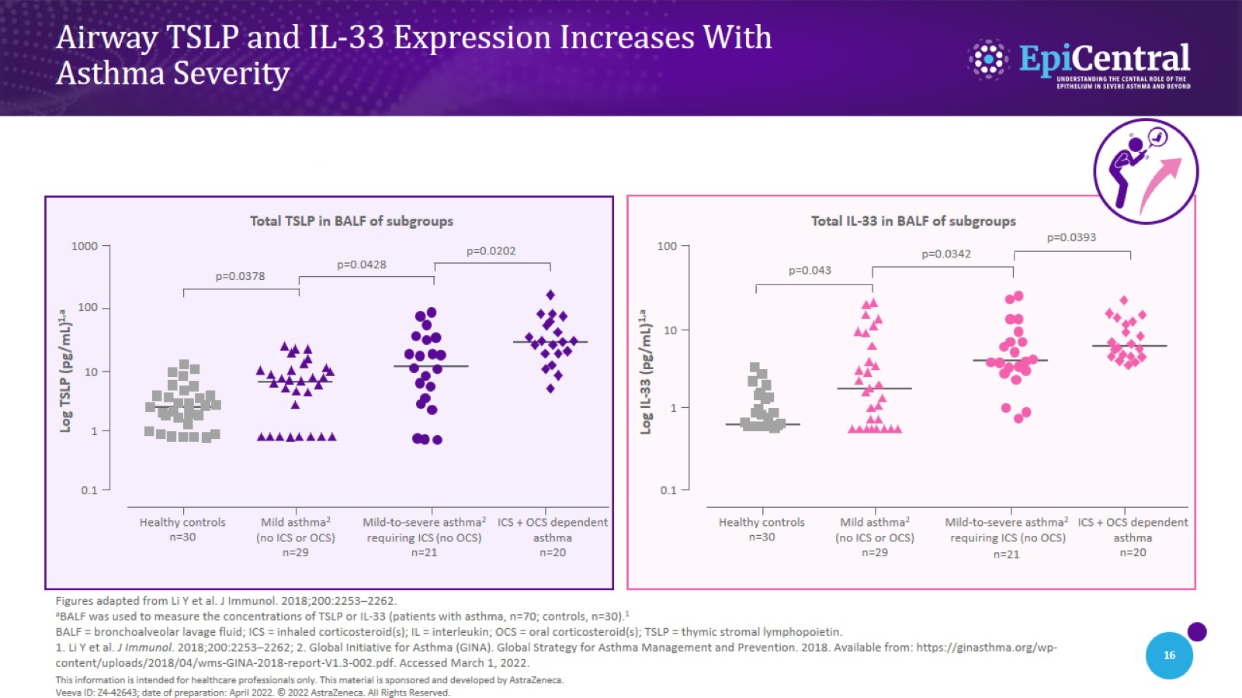
Airway TSLP and IL-33 Expression Increases With
Asthma Severity
CN-142727; date of preparation: Dec 2024. © 2025 AstraZeneca. All Rights Reserved. This information is intended for healthcare professionals only. EpiCentral is sponsored and developed by Amgen and AstraZeneca.

Slide 17
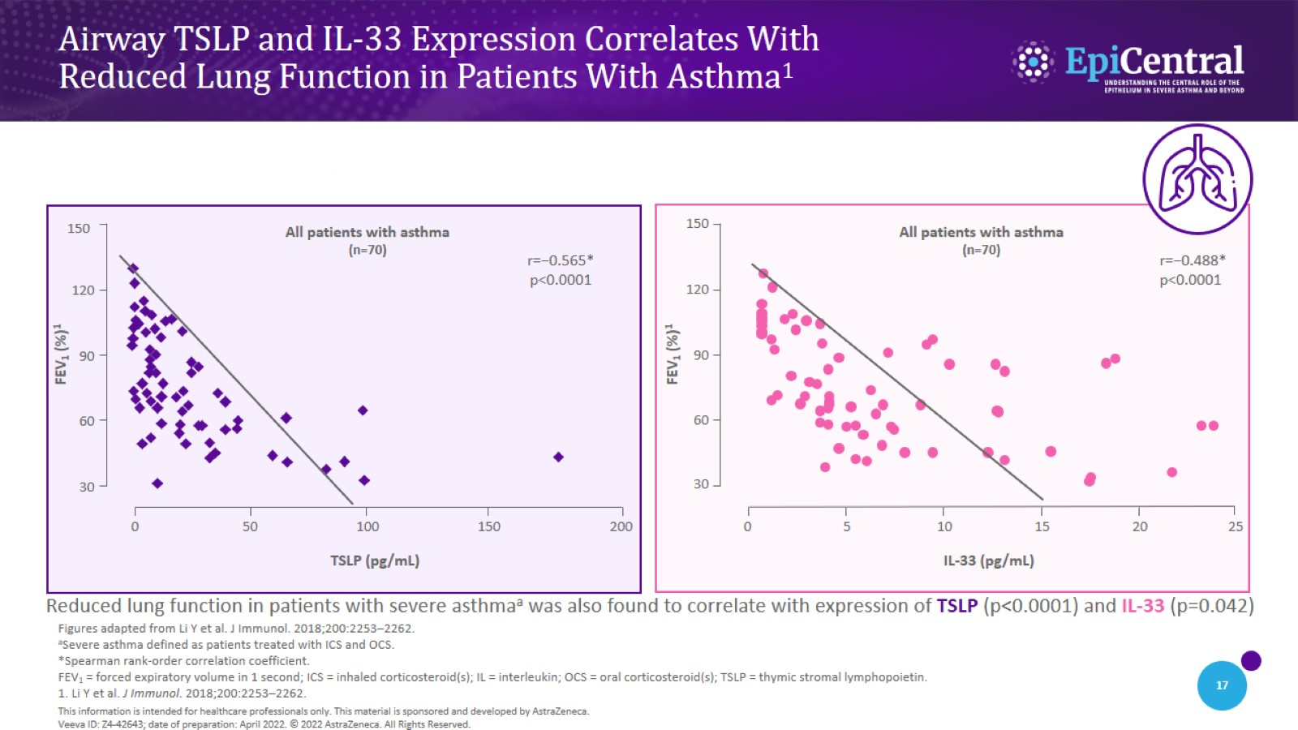
Airway TSLP and IL-33 Expression Correlates With
Reduced Lung Function in Patients With Asthma¹
CN-142727; date of preparation: Dec 2024. © 2025 AstraZeneca. All Rights Reserved. This information is intended for healthcare professionals only. EpiCentral is sponsored and developed by Amgen and AstraZeneca.

Slide 18
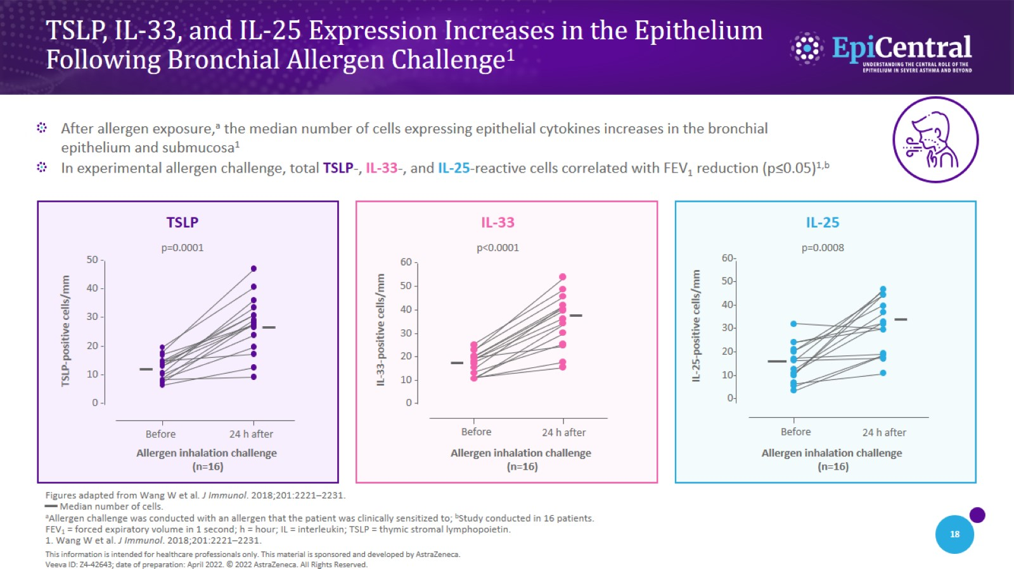
TSLP, IL-33, and IL-25 Expression Increases in the Epithelium
Following Bronchial Allergen Challenge¹
CN-142727; date of preparation: Dec 2024. © 2025 AstraZeneca. All Rights Reserved. This information is intended for healthcare professionals only. EpiCentral is sponsored and developed by Amgen and AstraZeneca.

Slide 19
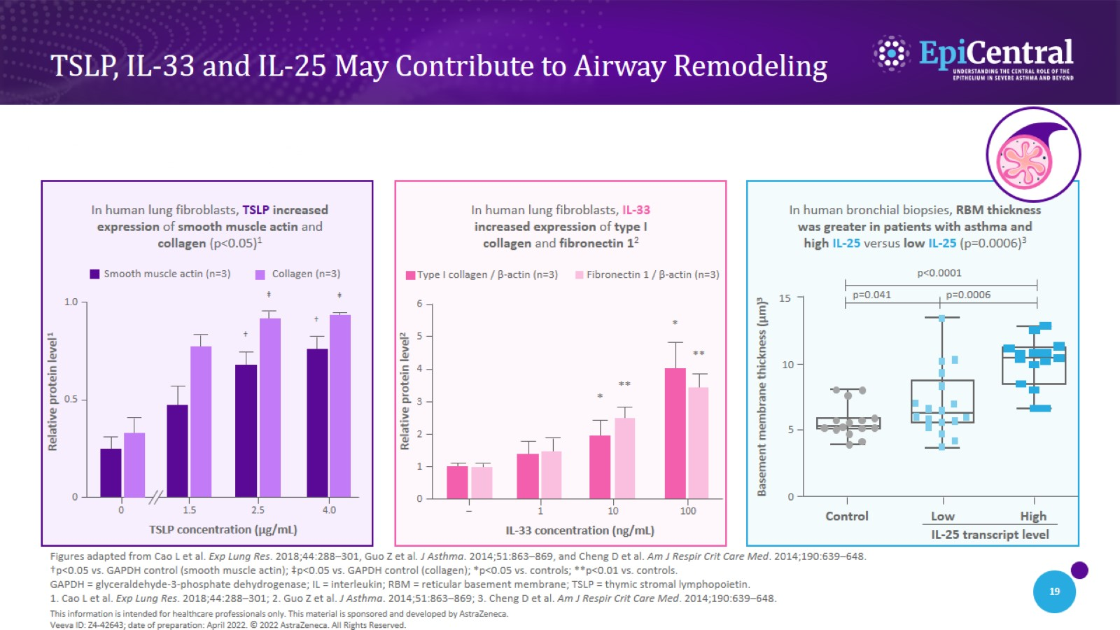
TSLP, IL-33 and IL-25 May Contribute to Airway Remodeling
CN-142727; date of preparation: Dec 2024. © 2025 AstraZeneca. All Rights Reserved. This information is intended for healthcare professionals only. EpiCentral is sponsored and developed by Amgen and AstraZeneca.

Slide 20
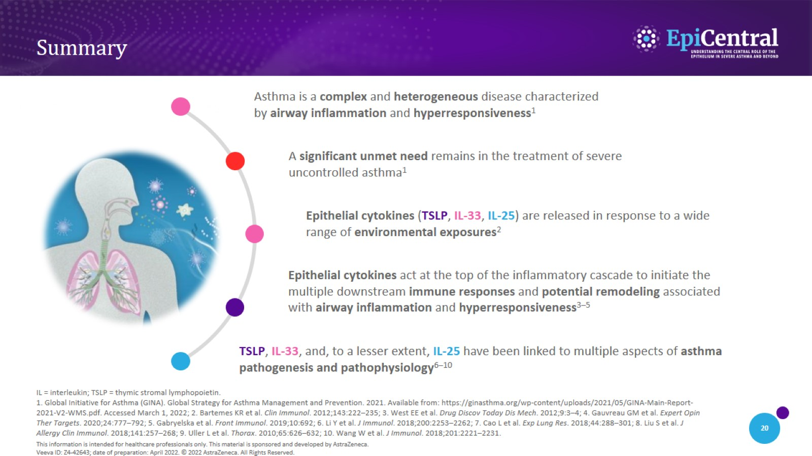
Summary
CN-142727; date of preparation: Dec 2024. © 2025 AstraZeneca. All Rights Reserved. This information is intended for healthcare professionals only. EpiCentral is sponsored and developed by Amgen and AstraZeneca.

